Slide 1

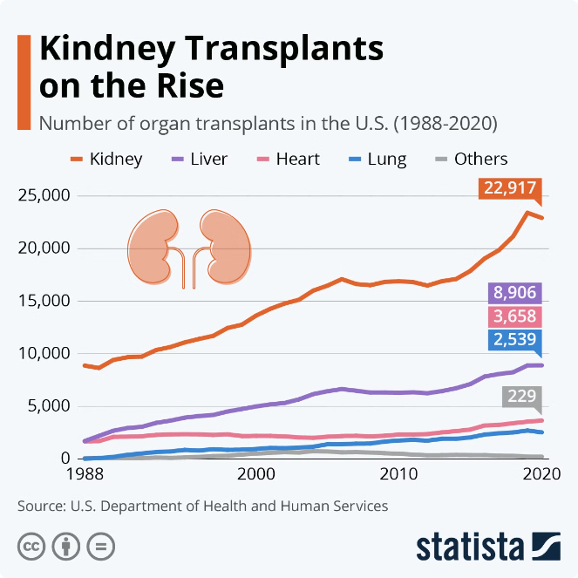
Predicting Chronic Kidney Disease with Machine Learning
Chronic Kidney Disease (CKD) poses significant global health challenges due to its high morbidity and mortality rates. Early stages of CKD often show no symptoms, making timely diagnosis difficult, especially for HIV patients who are at higher risk. Early detection is crucial for prompt care and delaying disease progression. Leveraging pathology data, this project employs machine learning, specifically Support Vector Machine (SVM), for CKD classification. Implemented with Python and Flask for backend and HTML/CSS/JS for the web interface, this solution aims to improve early CKD detection and patient outcomes.

Slide 2
Existing Approaches to Disease Prediction
Decision Tree Algorithms
Neural Networks
Limitations of Existing Approaches
Previous studies have explored the use of decision tree algorithms, such as the one proposed by E. Perumal et al., for predicting cardiovascular diseases. These approaches have shown promising results, but are known to be unstable, with small changes in data leading to significant alterations in the model structure.
Researchers like R. Shinde et al. have introduced the Multilayered Perceptron (MLP) separator for predicting hepatic cirrhosis in patients with Hepatitis B. While these neural network-based models have demonstrated strong predictive power, they can suffer from issues like complexity and the need for large training datasets.
The instability of decision tree models, the complexity of neural networks, and the reliance on large training datasets are key challenges that often limit the effectiveness of traditional disease prediction algorithms. This underscores the need for a more robust and efficient approach, such as the one proposed in this project.

Slide 3

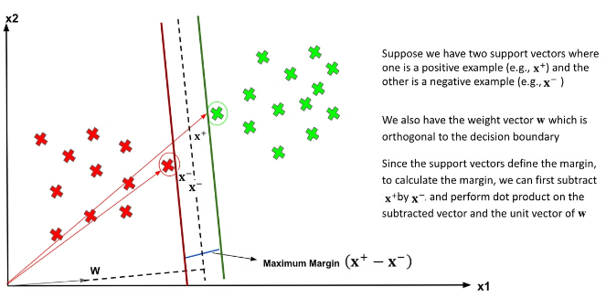
Proposed CKD Prediction Model
1
CKD Prediction
The primary goal of this project is to develop a machine learning model capable of accurately predicting the onset and progression of Chronic Kidney Disease (CKD). By leveraging the power of the Support Vector Machine (SVM) classifier, the team aims to create a robust and reliable tool for early CKD detection.
2
Feature Selection
Prior to applying the classification algorithm, the team will carefully select the most informative features from the available pathology data. This feature selection process is crucial for enhancing the model's performance and ensuring the most accurate CKD predictions.
3
Experimental Analysis
The project will involve a thorough exploration of various machine learning techniques and extensive experimental analysis to identify the optimal algorithm for effectively classifying different stages of CKD. This rigorous approach will help ensure the model's reliability and efficiency in real-world healthcare settings.

Slide 4

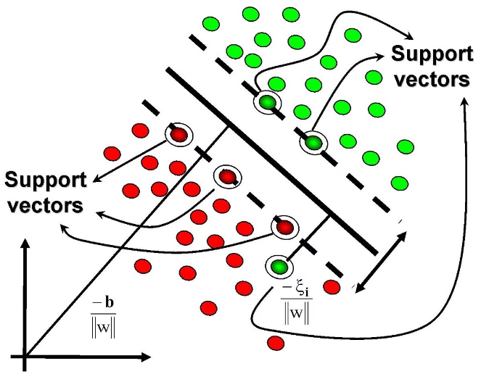
Advantages of the Proposed SVM Model
1
Higher Accuracy
The proposed SVM classifier has achieved an impressive 94% accuracy in predicting CKD, outperforming many existing systems and demonstrating its effectiveness in this critical medical application.
2
Optimal Performance
SVM is widely regarded as one of the best classifiers available, with its ability to effectively separate labeled data and handle complex, non-linear relationships making it well-suited for medical and biological applications.
3
Tuned Parameters
The team has carefully tuned the SVM parameters to achieve the best possible classification results, leading to excellent accuracy, precision, recall, and F1-score metrics.
4
Kernel Function
The SVM's use of kernel functions allows for the labeling and classification of complex data structures, such as DNA and protein sequences, making it a powerful tool for healthcare and life sciences applications.

Slide 5
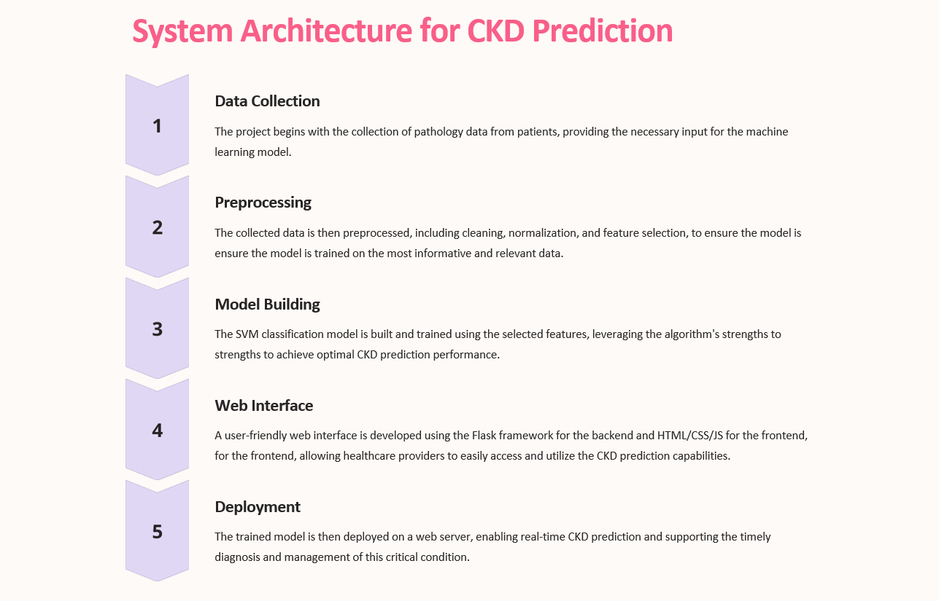
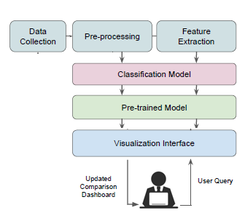

Slide 6
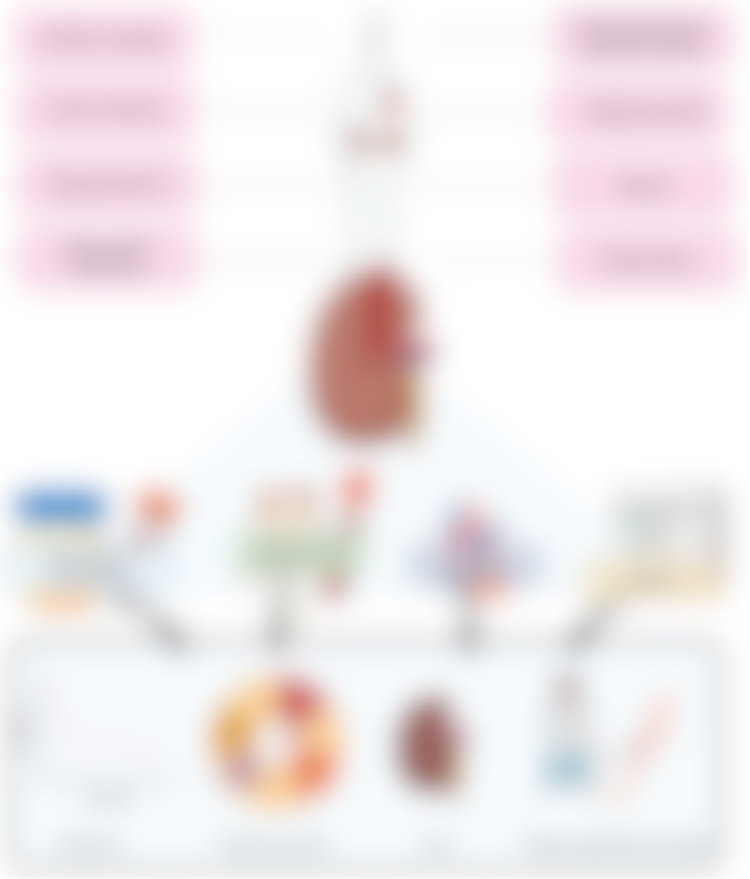
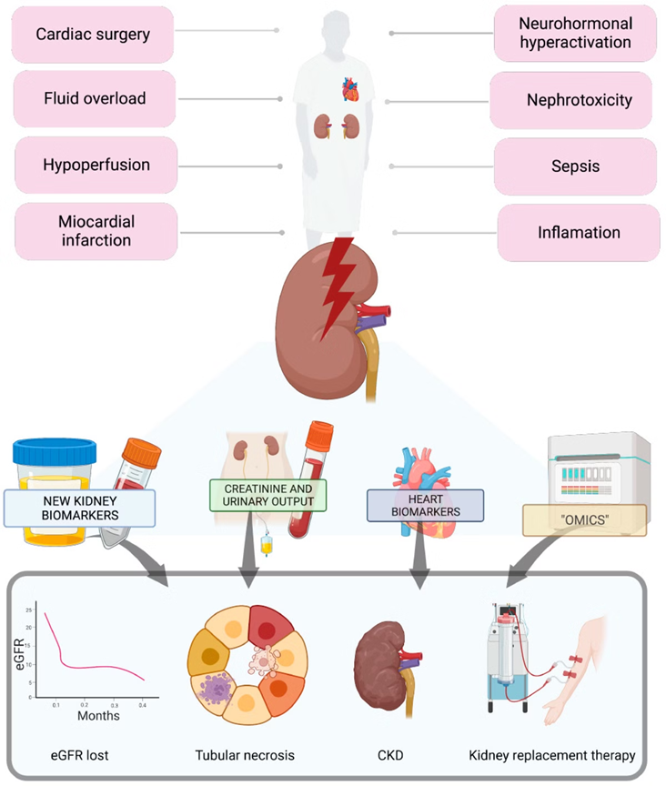
Enhancing CKD Prediction with Feature Engineering
Biomarker Analysis
By closely examining various biomarkers associated with CKD, such as creatinine levels, glomerular filtration rate, and urine albumin-to-creatinine ratio, the project team can identify the most informative features to include in the machine learning model.
Temporal Analysis
Examining the longitudinal trends and changes in biomarkers and clinical data over time can offer valuable insights into the dynamic nature of CKD, enabling the model to better capture the disease's progression and improve the accuracy of predictions.
Personalized Modeling
By tailoring the machine learning model to individual patient characteristics and risk factors, the project can deliver more personalized CKD predictions, allowing healthcare providers to develop targeted interventions and treatment plans.

Slide 7



Improving CKD Prediction through Model Optimization
Data Collection
Data Preparation
Model Selection
Comprehensive data gathering from various sources, including web scraping and manual interventions, to build a robust dataset for model training.
Rigorous data cleaning, normalization, and feature selection to ensure the machine learning model is trained on the most informative and relevant data.
Choosing the robust and accurate Support Vector Machine (SVM) algorithm, which is well-suited for complex medical data classification tasks.

Slide 8

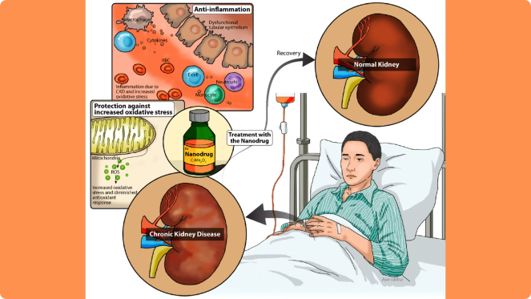
Delivering Actionable Insights for CKD Management
Early Detection
By accurately predicting the onset and progression of CKD, the machine learning model can enable healthcare providers to identify high-risk individuals and intervene at the earliest stages of the disease.
Personalized Care
The model's ability to tailor predictions to individual patient characteristics can support the development of personalized treatment plans, considering the unique risk factors and clinical profiles of each patient.
By continuously monitoring patients and updating the CKD predictions, the system can help healthcare providers optimize their resource allocation and ensure that patients receive the appropriate level of care throughout the disease progression.
Efficient Monitoring
Informed Decision-Making
The insights generated by the machine learning model can healthcare providers to make more informed decisions regarding treatment options, patient education, and the implementation of preventive strategies to mitigate the impact of CKD.

Slide 9

Hardware Requirements
Processor: Intel Pentium i3 or equivalent
Storage: 500 GB Hard Drive or SSD
Display: 15" LED Monitor or similar
Input Devices: Keyboard and Mouse
Memory: 4 GB RAM or higher

Slide 10

Software Requirements
Operating System: Windows 10
Coding Language: Python
Web Framework: Flask
Development Environment: VS Code or PyCharm

Slide 11


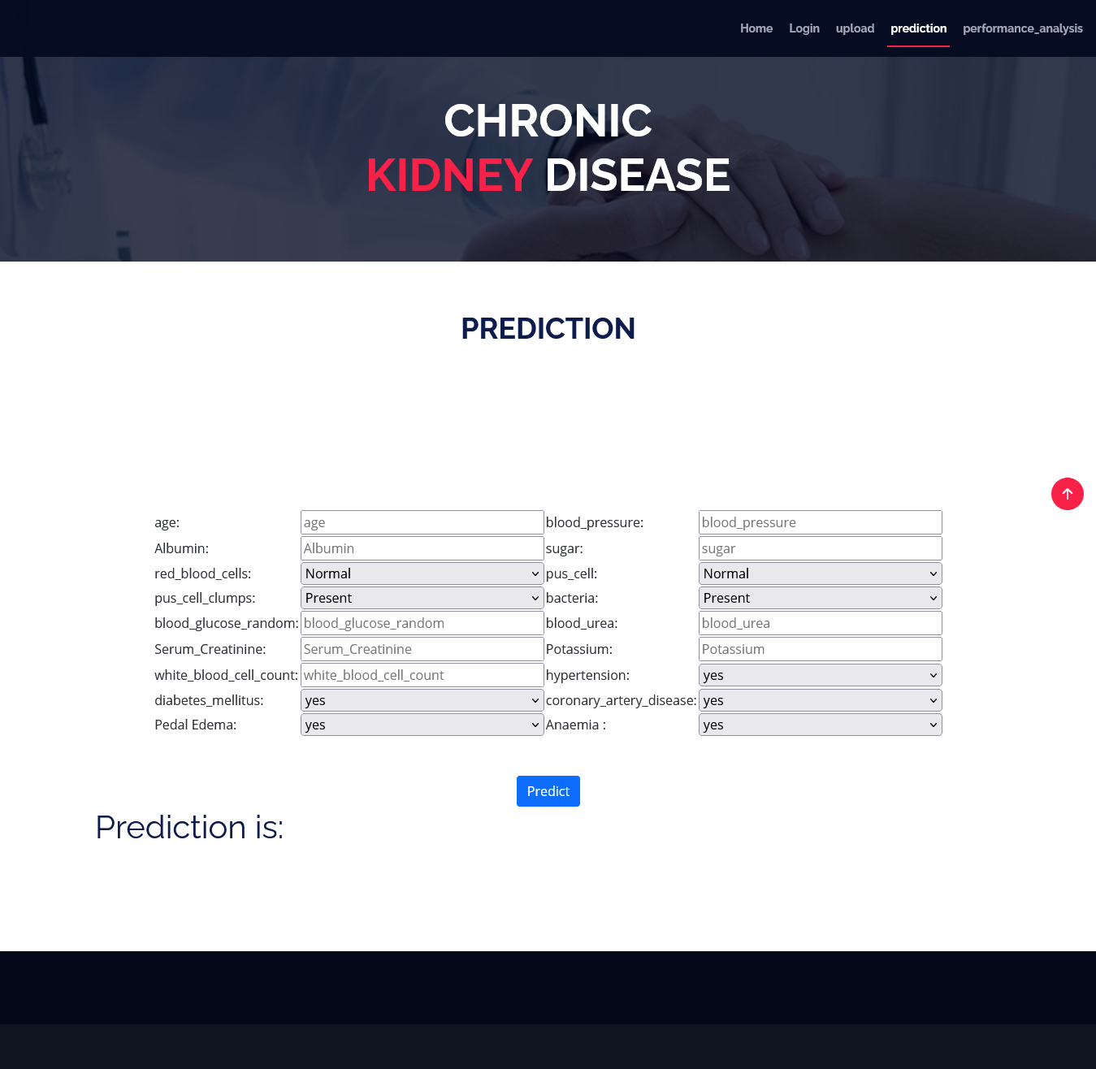
Conclusion: Unlocking the Potential of ML for CKD Management
This project demonstrates the immense potential of machine learning techniques, specifically the Support Vector Machine classifier, in addressing the global challenge of Chronic Kidney Disease. By leveraging the power of data-driven prediction models, healthcare providers can now access a reliable and accurate tool for early CKD detection, personalized treatment planning, and efficient disease management.
As the project continues to evolve and refine its approaches, the team remains committed to delivering actionable insights that can transform the way we approach this critical medical condition, ultimately improving patient outcomes and reducing the burden on healthcare systems worldwide.

